Slide 1
Jan Alexander Point-supervised segmentation of human spine

Slide 2
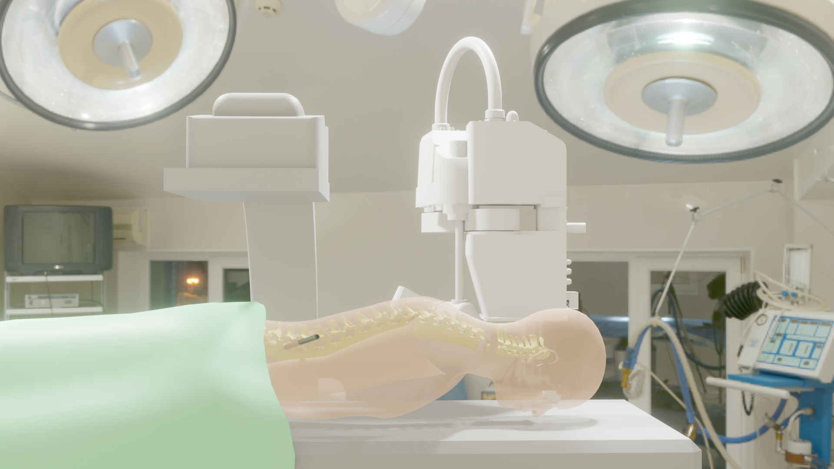
Broad view of project: Addition to REISS project Verhaert

Slide 3
Broad view of project: Addition to REISS project IMEC-Verhaert
Robotical support for operation herniated lumbar spine
Individual segmentation of Lumbar spine Vertebrae would be welcome addition to project outcome.

Slide 4
Thesis objective
Semi-supervised training vs fully supervised training:
Compare instance segmentation based on fully-supervised trained model and point-annotated trained model
Possible addition:
After automatic segmentation, improve result by manually indicating points that are wrongly classified.

Slide 5
General overview
Preprocessing
Model trained on fully segmented data
vs
Model
Model trained on point-annotated data
Visualisation

Slide 6
Progress sem. 1 less than expected
Progress made
Literature review
Dataset search
Since 23/11/2020: 2 extra datasets found
3 interesting code repo’s found (and many less interesting)
Progress lag behind:
Start exploration of existing code
Proper write out

Slide 7
Data-set search
Dataset | Quantity | Type | Annotation | Data format
UWSpine-CT | 200 scans (some with severe scoliosis) | CT-scan | Point-annotation | NifTi
xVertSeg-CT | 20 | CT-scan | 15 fully segmented 5 unsegmented | MHD ITK Meta-Image
UniSiegen – Zukic | 17 | MRI | Full volume segmentation | DICOM
OSF Sarah Schlaeger | 54 | MRI | Full volume segmentation | DICOM
Zenobo | 23 | MRI | Full volume | NII
Spineweb |  |  |  | Jpeg files
MICCAI 2016 |  |  |  | Prof JM Pozzo No answer
IVDM3Seg |  |  |  | Prof Guoyan Zheng New job

Slide 8
Remarks on data
Quantity:
109 images with full vertebra labelling
With inter-expert differences, less/no pathologies
200 point annotated vertebra (with some examples of severe sclerosis)
Volume labels can be converted to point annotation:
mean + Gaussian noise
Type:
Both MRI and CT-scan images
Different file formats
→ preprocessing needed:
Intensity matrix
Find conversion such that bone has comparable intensity

Slide 9
General steps
Preprocessing
Hold out test set of 25 fully labelled images (final score: mean dice score on each vertebra) → 84 fully labelled images to train on.
+ 5 unlabelled images from xVertSeg-CT for visual inspection
Models:
Train model on fully labelled samples (84 images, 70-30 train/val)
Bench-mark on validation set
Point supervised model:
With 84 images volume labels → points: compare performance to benchmark
Train with extra 200 point annotated images

Slide 10
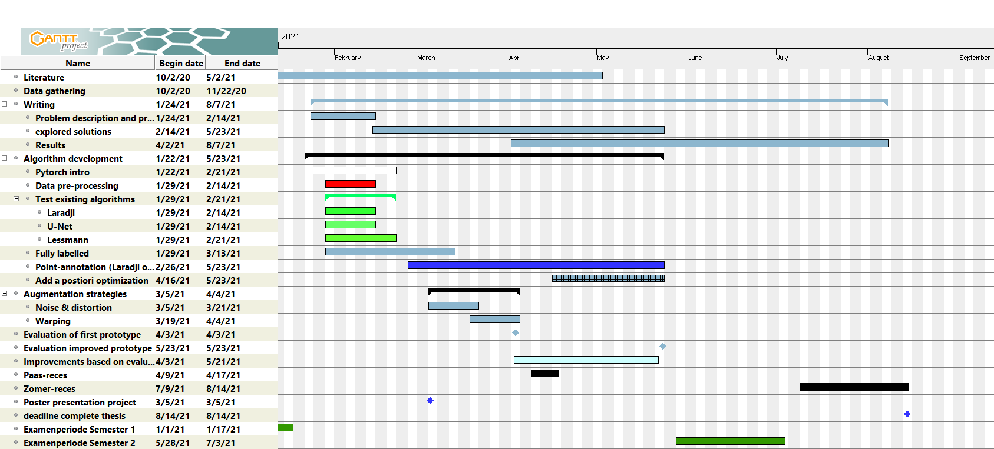
Timeline
Start with fully segmented part
First milestone: Paas-reces for ‘prototype’ of model based on point annotation

Slide 11
First model to test
U-net based
Variations by Chuang, and Lessman
Laradji: WISe algorithm → investigate how to marry this into Unet…
Not straigth to implement this in

Slide 12
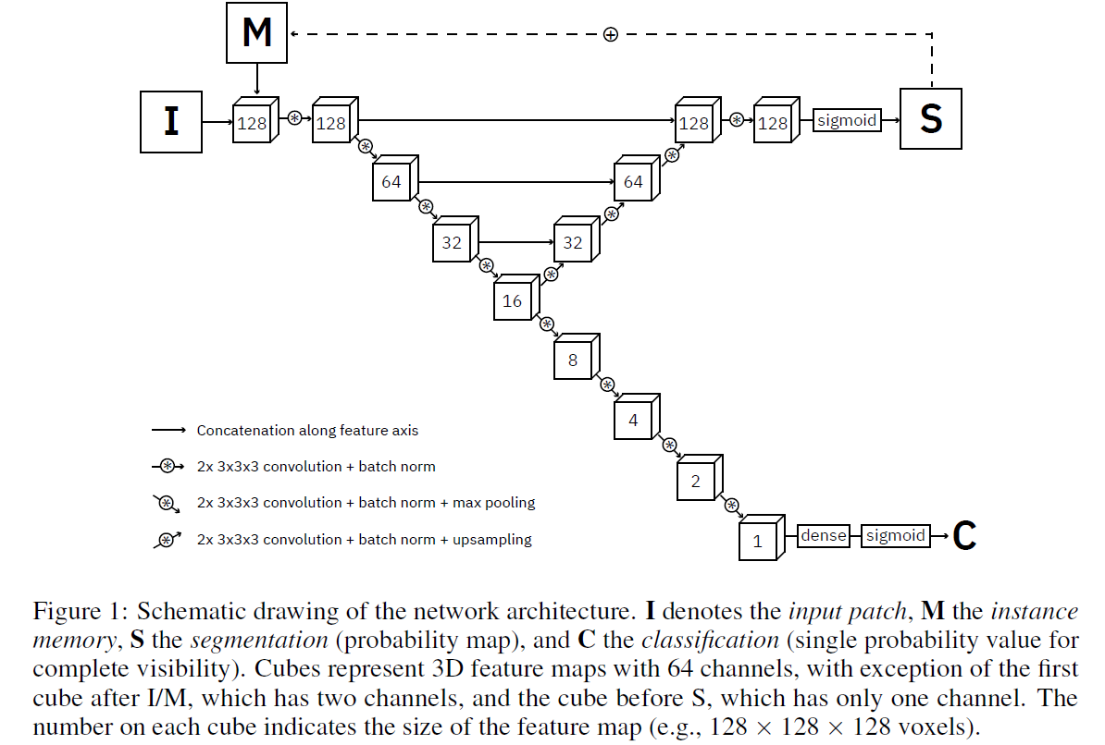
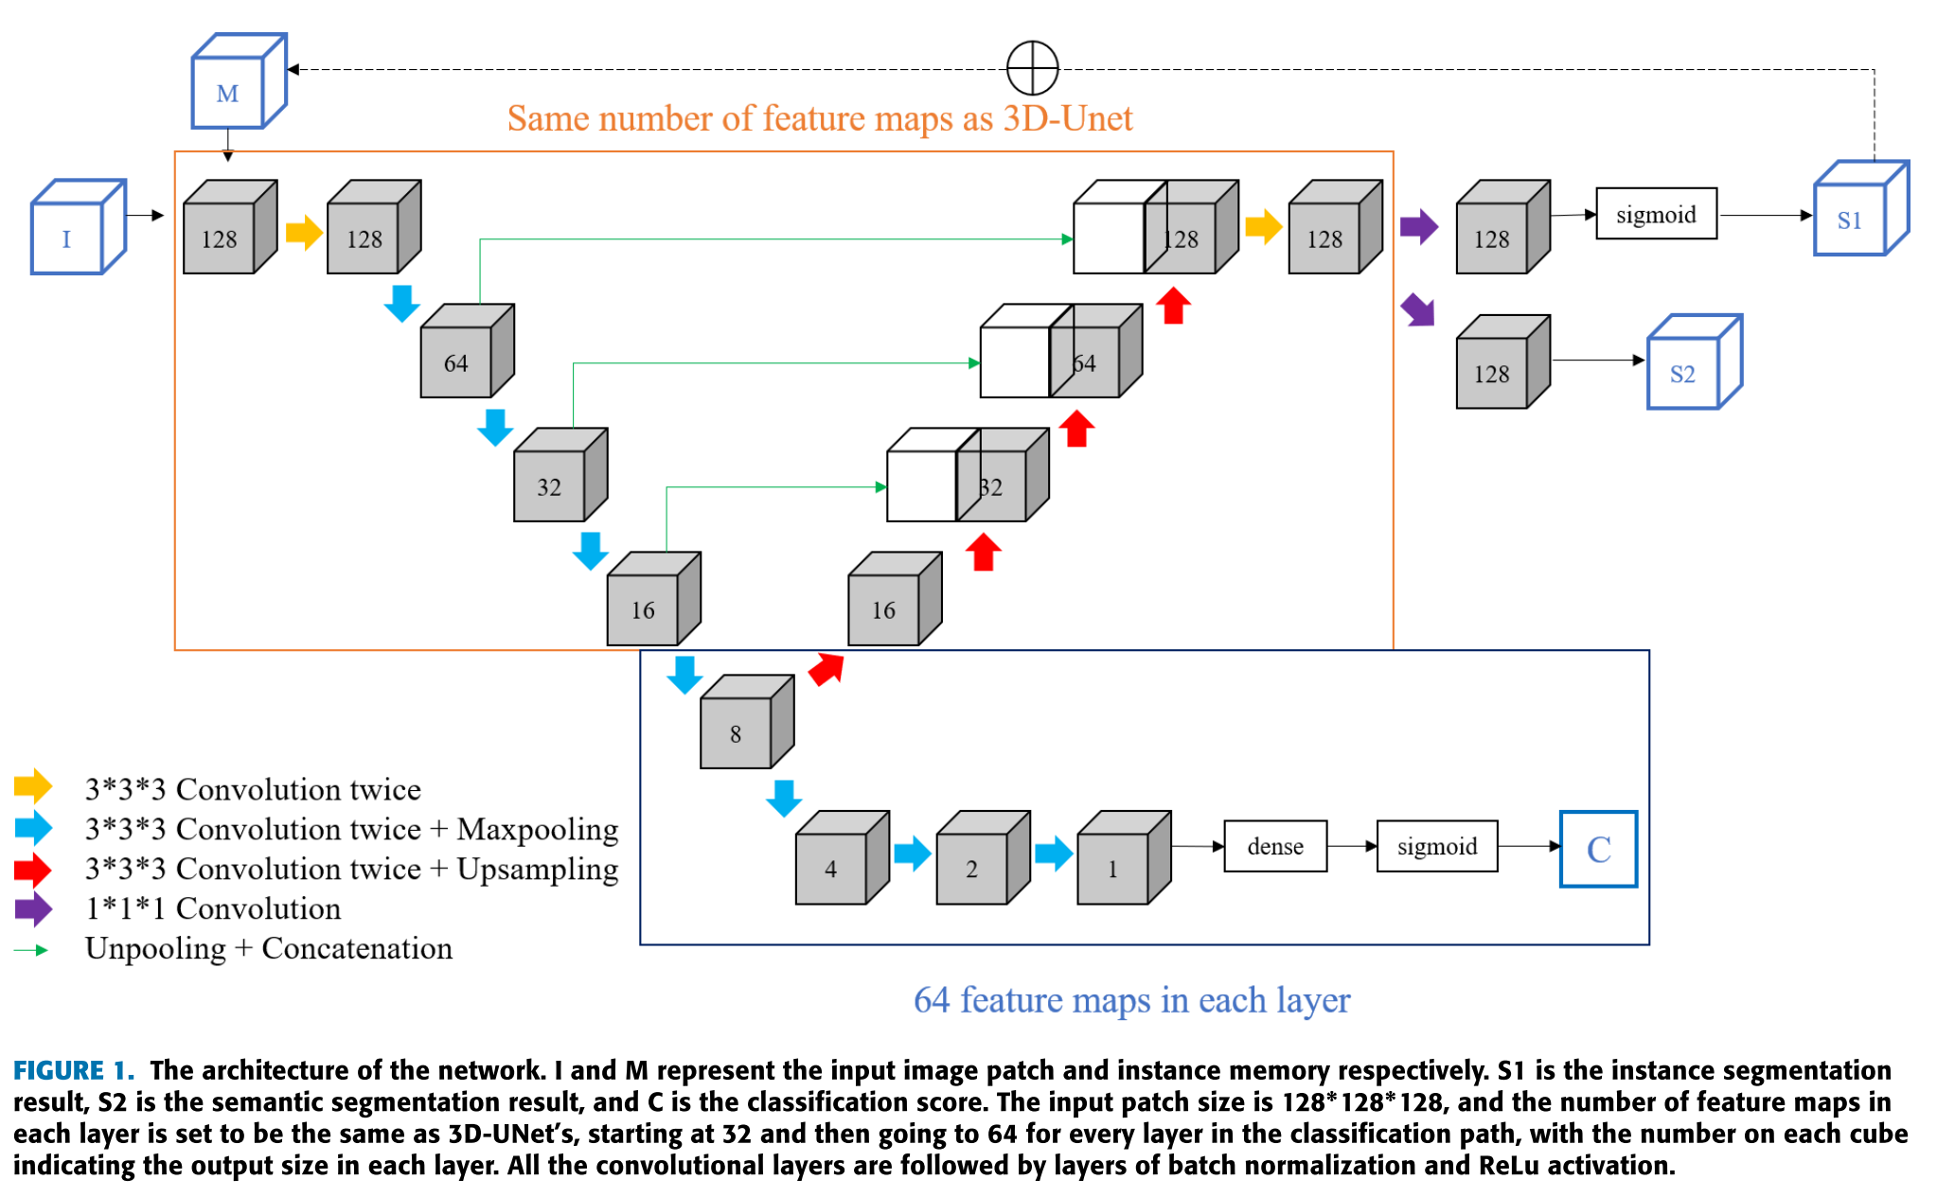
Unet
Lessman
Implementation available
(in PyTorch)
Chuang

Slide 13
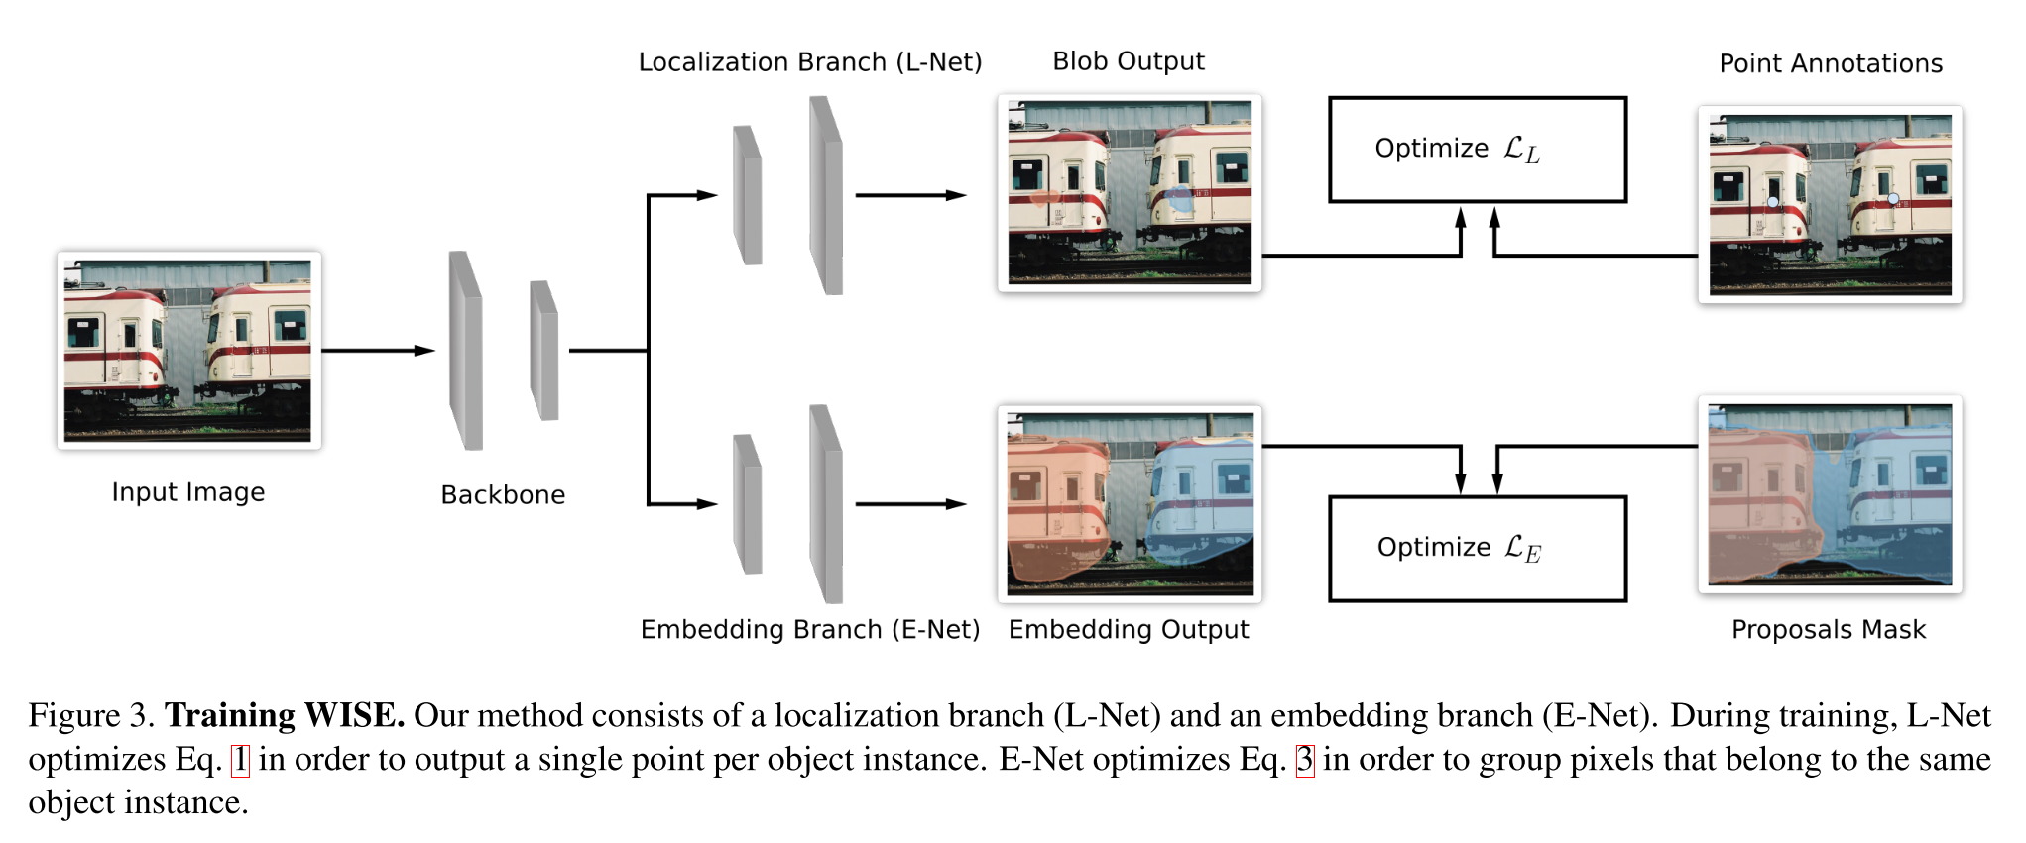
Point-annotation
Laradji:
Code for 2D problems available → first task: understand optimization better
Chuang

Slide 14
Next meeting
26/02/2021:
How wel does U-Net work?
Progress on Laradji
Line-out of document

